Slide 1
Introduction to Software Business Product management
Week 3 Day 1
Led by: Emily Crose
for
Oakland University

Slide 2
Review of Week 2

Slide 3


Questions From Week 2?

Slide 4
Terms to listen for
Sprint
A period of focused development
Roadmap
An overarching plan for development

Slide 5
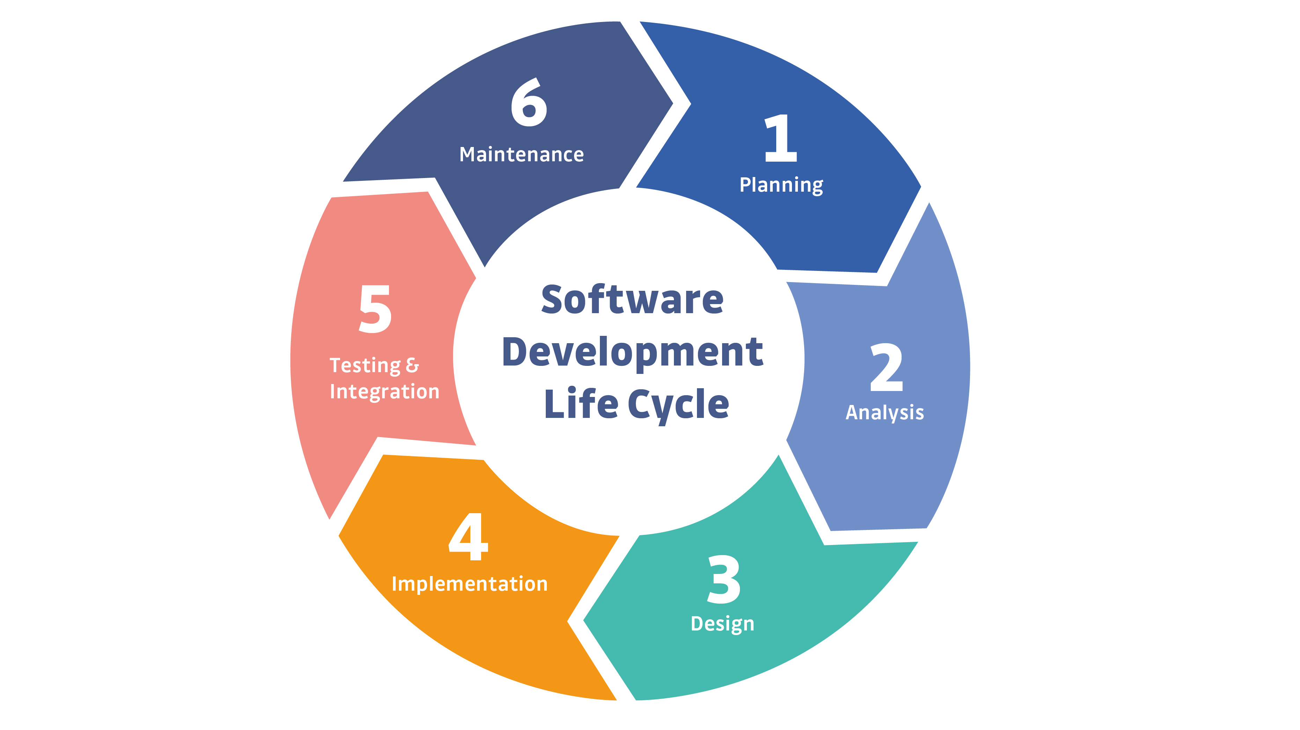
Notes:
This is a simple example of the SDLC. Typically, representations of the SDLC will have around 6 steps, but the steps will generally match what you see here.

Slide 6
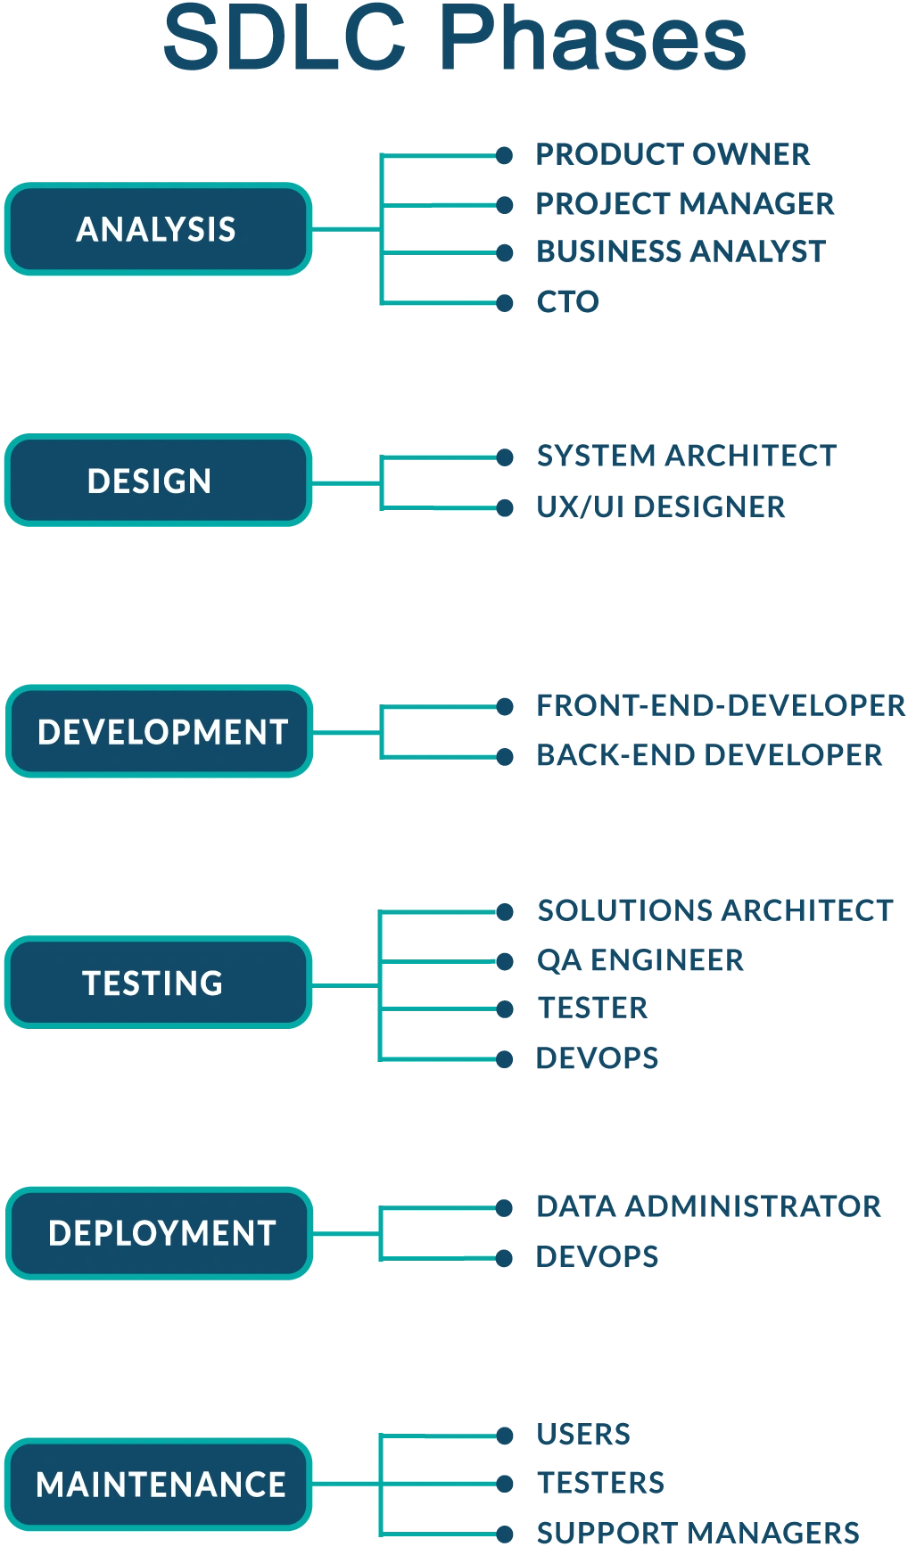

Slide 7

SDLC Step 1: Planning

Slide 8
Roles in Step 1
Product owner
Project manager
Business analyst
CTO

Slide 9
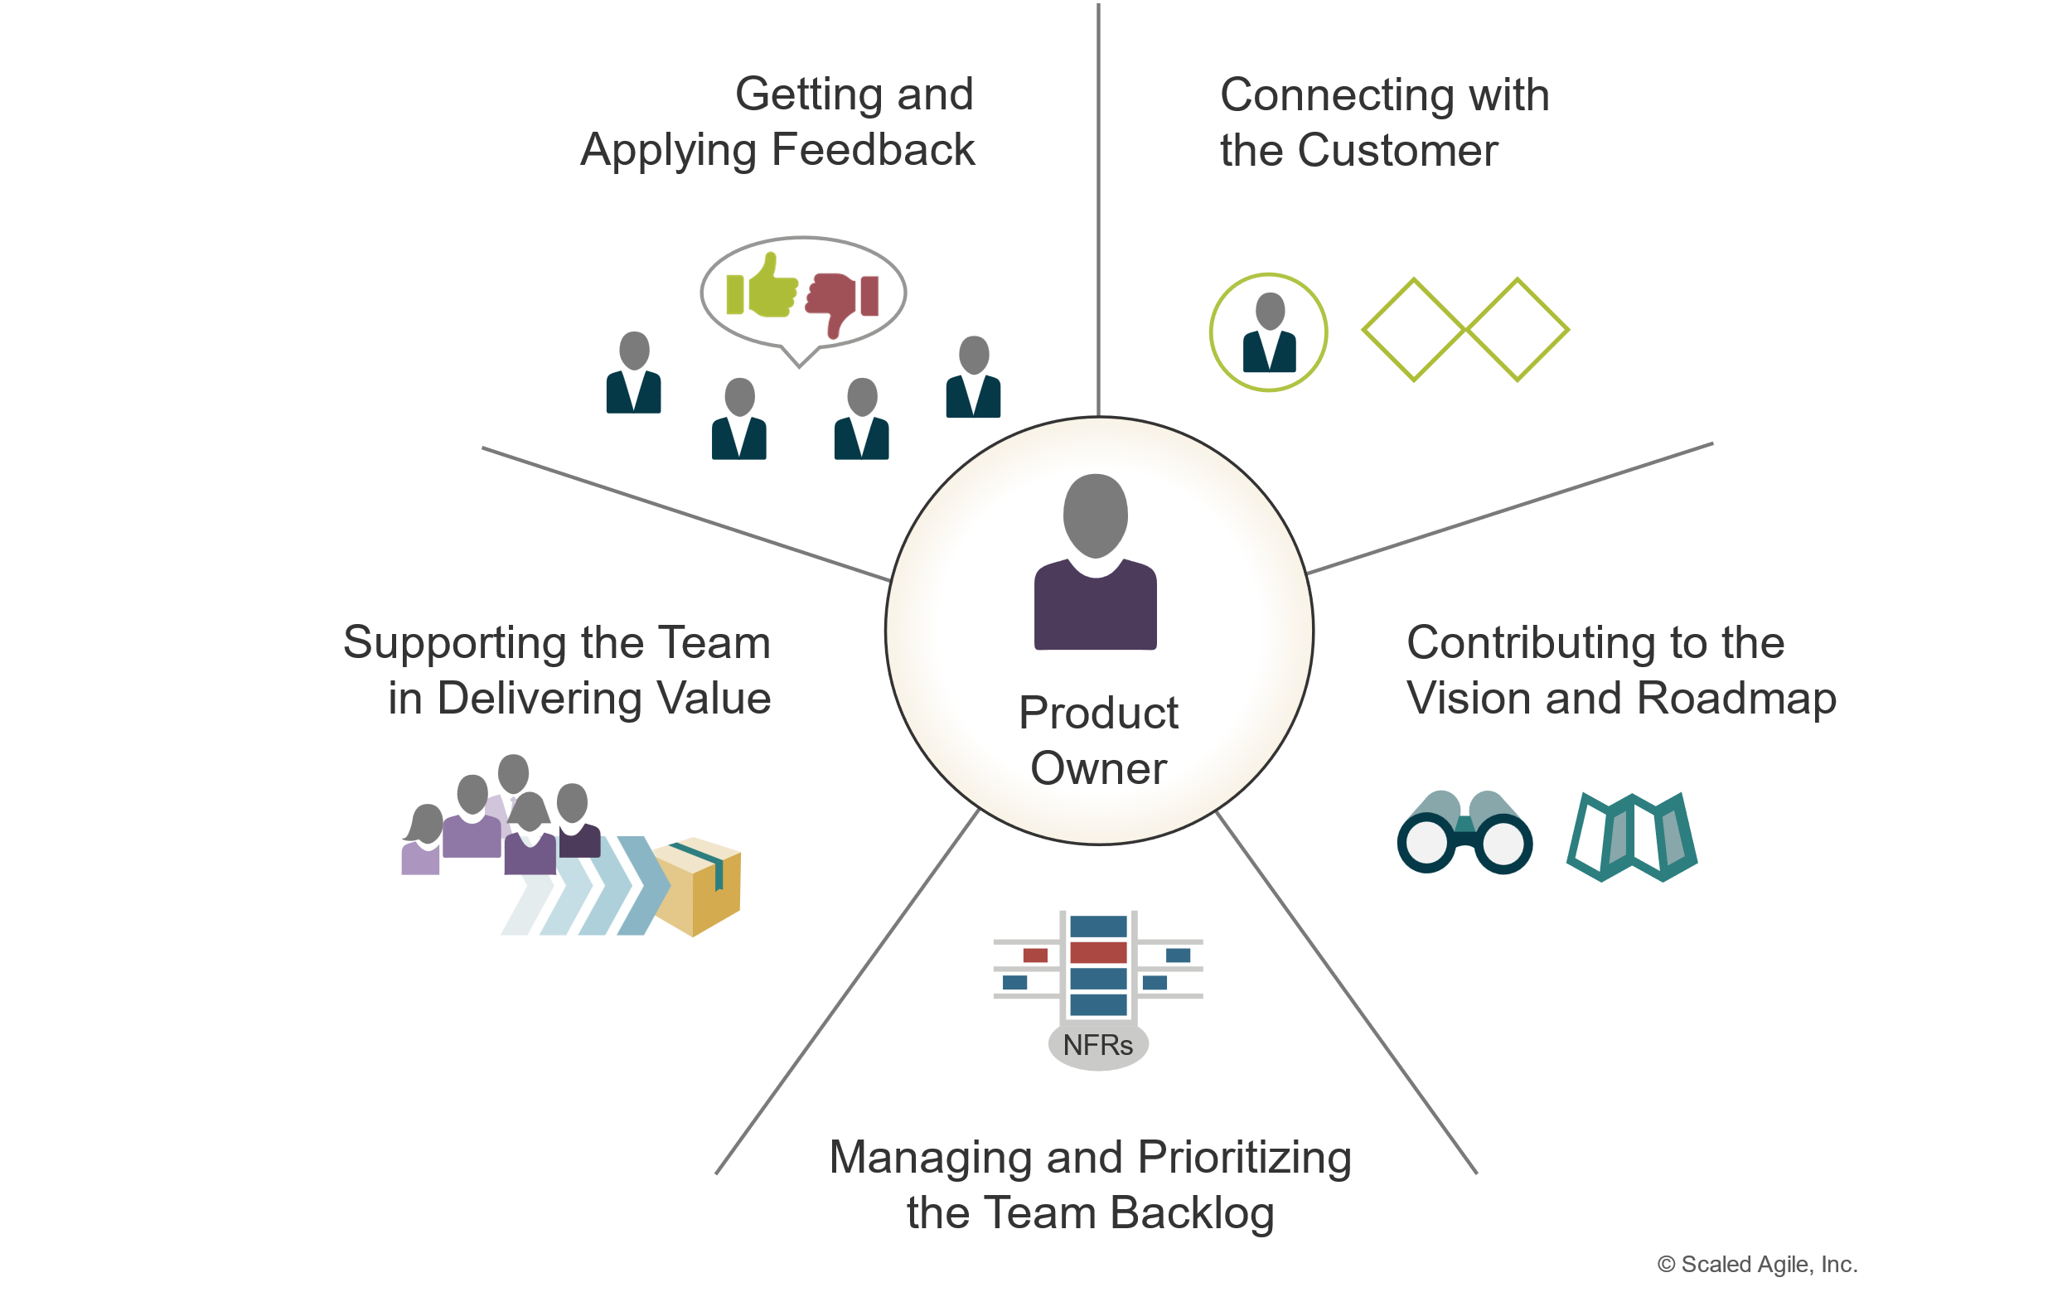
Product Owner
Notes:
According to Agile, the product owner undertakes the

Slide 10
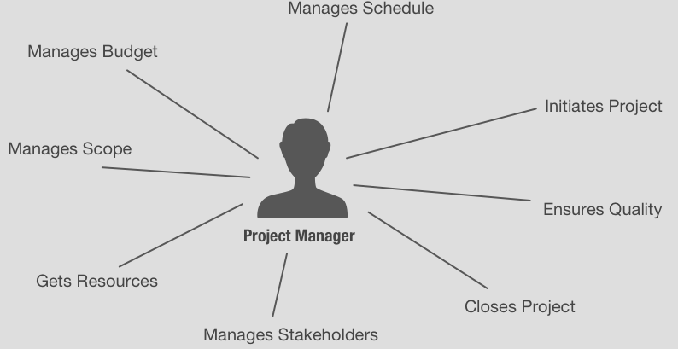
Project Manager Role

Slide 11
Business Analyst
Gathers & tracks product requirements
Stake holder consent
Documentation
GAP analysis
User testing

Slide 12
CTO
Provides top-cover for decision making
Budgeting

Slide 13
Planning Activities
Gathering requirements
Planning solutions
Planning sprints
Road-mapping

Slide 14
Gathering Requirements
What problems do we need to solve with an app?
How do we our app to solve those problems?
What environment(s) will our app run on?

Slide 15
Planning Solutions
Given our requirements, what features do we need?
What dependencies do we have to make the features functional?
Libraries?
What should our interface look like?

Slide 16
Planning Sprints & Road-mapping

Slide 17

Organizational Tool: Jira

Slide 18
Jira Features
Create & assign tasks (or “tickets”)
Track ticket progress
Organize tasks
Integrate with other Atlassian organizational tools
Confluence
Bitbucket

Slide 19
Roadmaps

Slide 20
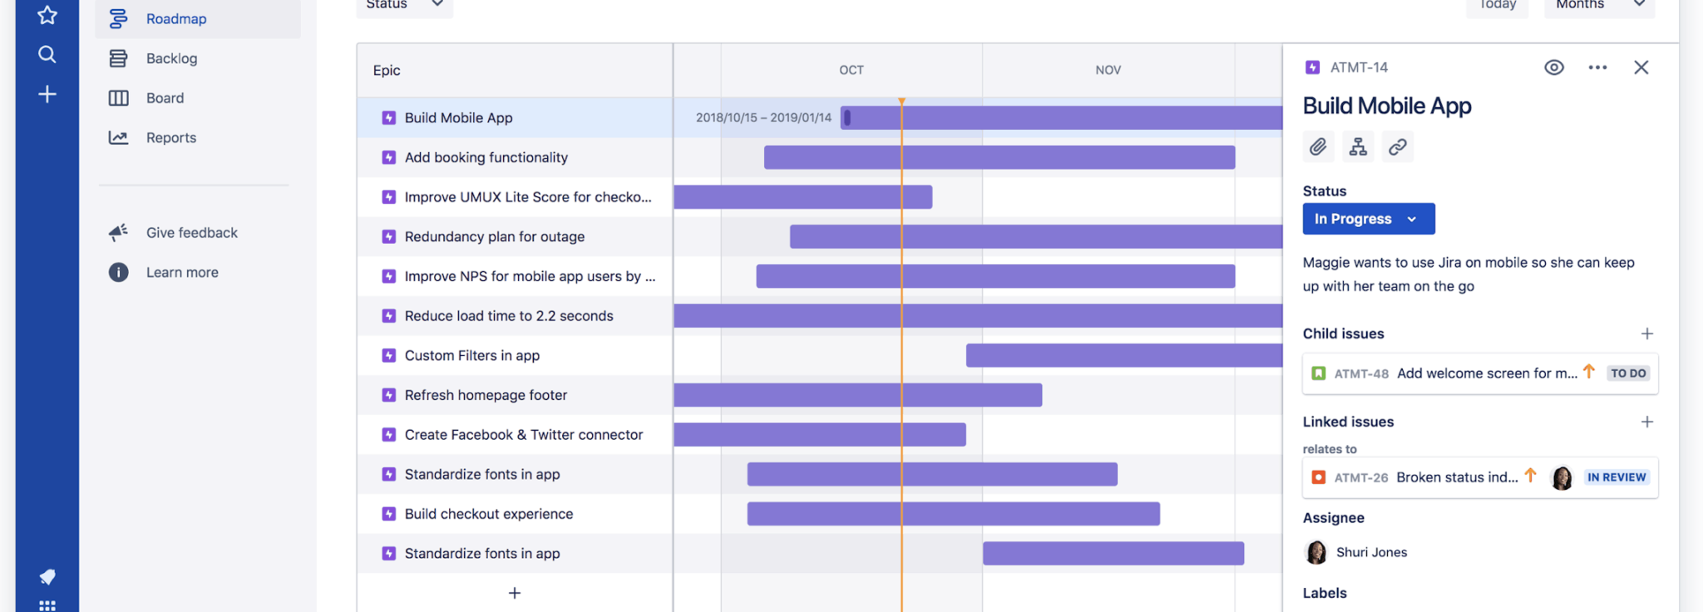

Slide 21
Epics
Overall tasks are organized into Epics
Epics are made up of tasks
Each task can have subtasks

Slide 22
Step 2: Analysis Roles

Slide 23

Review Day 1

Slide 24

Question or clarifications?

Slide 25

Preview day 2

Slide 26

See you next time!

